Slide 1
The Walk
Helps for modeling our lives after Jesus Christ

Slide 2
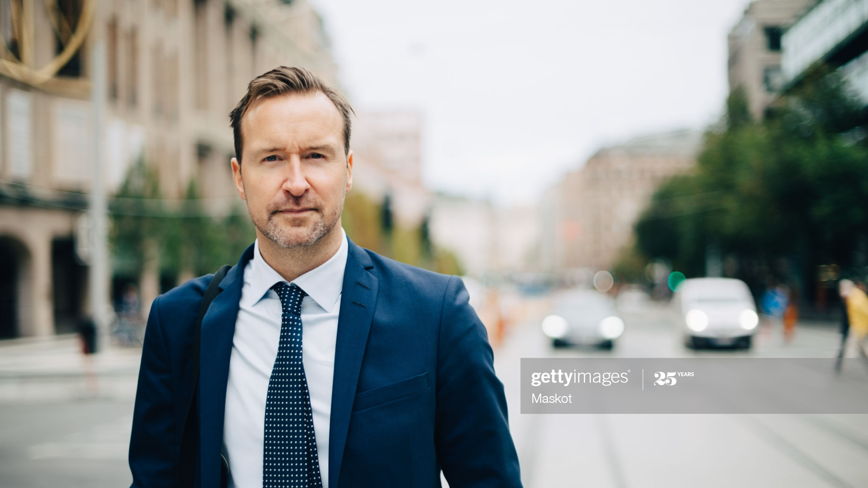
Wherever We Go

Slide 3
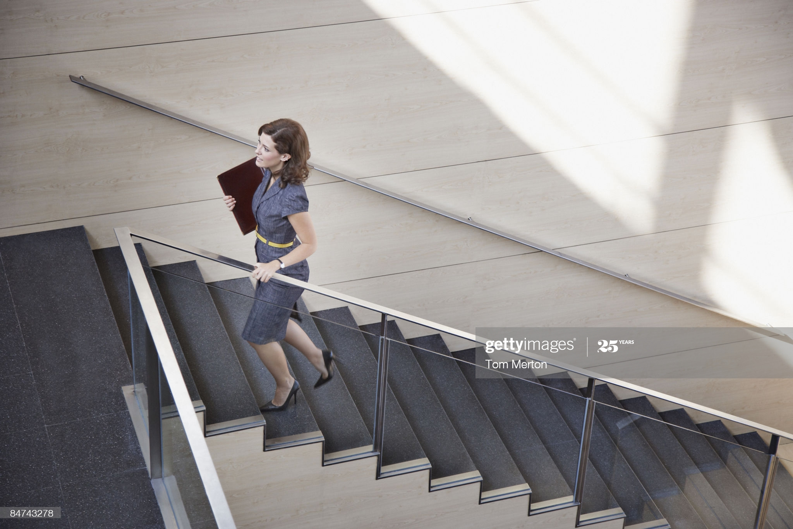
Whatever We Do

Slide 4
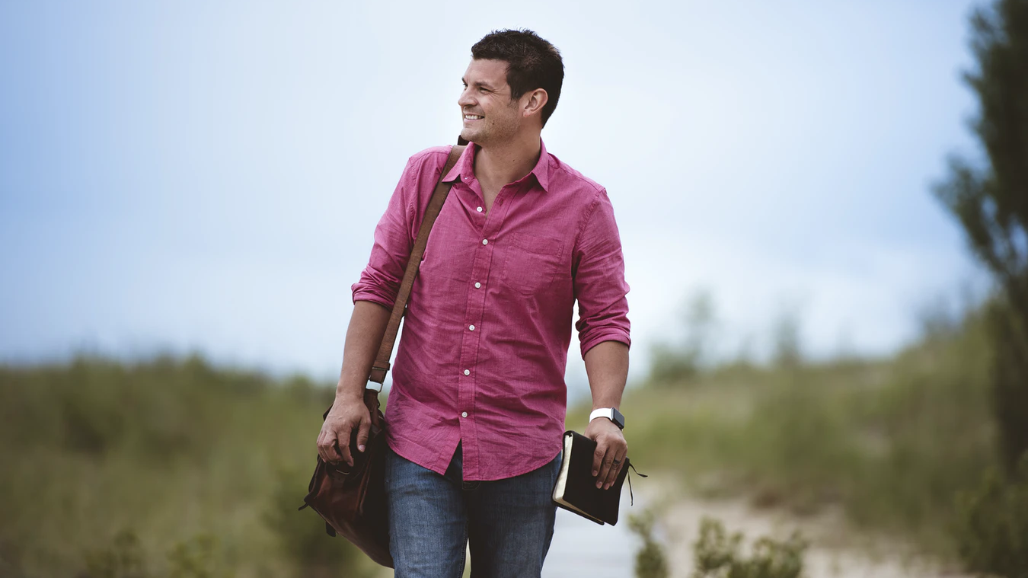
The Lord Wants Us To Be Holy
Holy = Different

Slide 5
Stand Out As Different

Slide 6
We were buried with Him through baptism into death,
that just as Christ was raised
from the dead by the glory of the Father, even so we also should
walk in newness of life.
Romans 6:4

Slide 7
We were buried with Him through baptism into death,
that just as Christ was raised
from the dead by the glory of the Father, even so we also should
walk in newness of life.
Romans 6:4

Slide 8
Living our lives after the model of the Lord Jesus Christ
For God called you to do good, even if it means suffering,
just as Christ suffered for you.
He is your example, and you must follow in his steps.
He never sinned, nor ever deceived anyone.
He did not retaliate when he was insulted,
nor threaten revenge when he suffered.
He left his case in the hands of God, who always judges fairly.
1 Peter 2:21-23

Slide 9
Walk (figuratively) how we live or conduct our behavior.
Thoughts
Words
Actions
Notes:
Rodion Kutsaev

Slide 10
He who follows Me shall not walk in darkness but have the light of life. John 8:12

Slide 11
But is there much difference in behavior between Christians & Non-Christians

Slide 12
Born Again Christians:
27%
Non-Christians:
23%

Slide 13
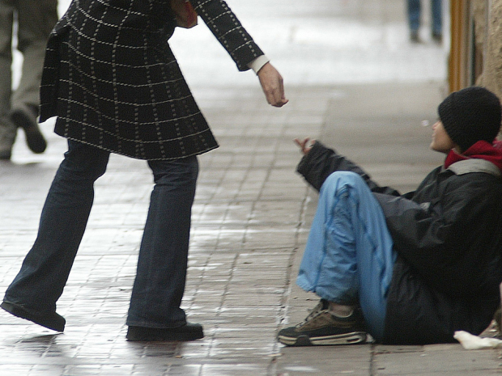
Gave money to help the poor
Born Again Christians:
24%
Non-Christians:
34%

Slide 14
Donated money to
a nonprofit organization
In the past month
Born Again Christians:
47%
Non-Christians:
48%

Slide 15
Still trying to figure out
the purpose of life
Born Again Christians:
36%
Non-Christians:
47%

Slide 16
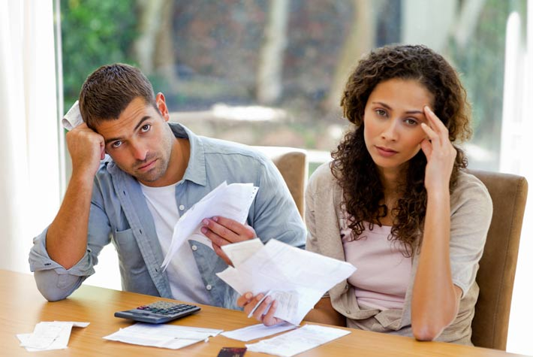
Find it impossible
to get ahead
because of financial debt
Born Again Christians:
33%
Non-Christians:
39%

Slide 17
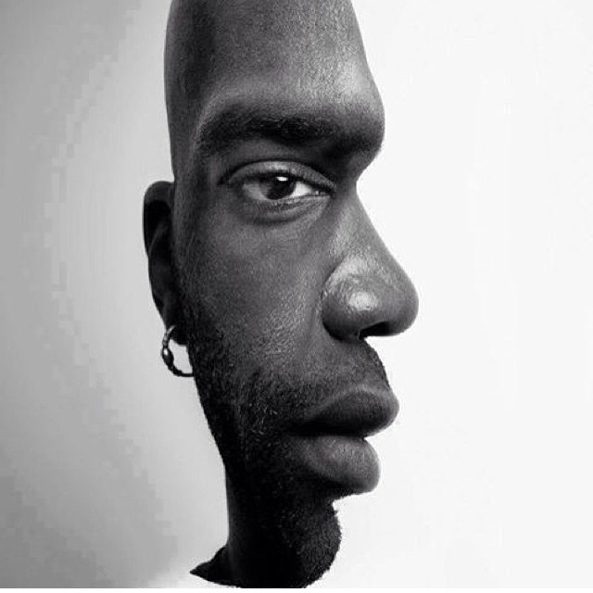
Almost the same No Difference
WHY?

Slide 18
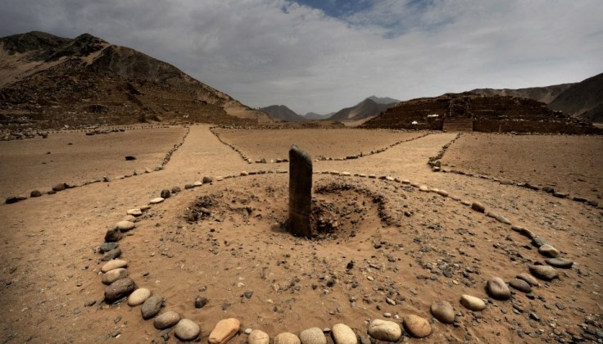
Spiritual Battle

Slide 19
Problems From The Beginning

Slide 20
A Response is Often Feeling Like a Victim
Notes:
Peter Oxela

Slide 21
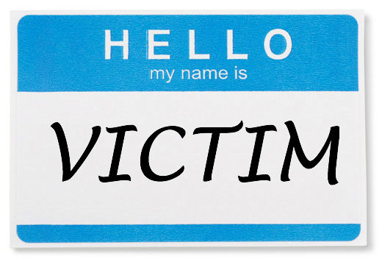
EVERYDAY VICTIM STATEMENTS
Do these sound familure?

Slide 22
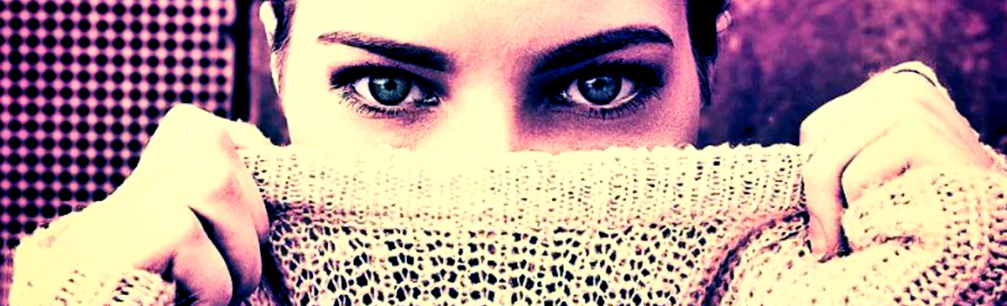
It’s not my fault
I’m sick and tired of ___
Nothing I do makes any difference
Look what you made me do
You hurt my feelings
I want an apology

Slide 23
What about me?
I can’t help it that is just the way I am
I’ve done everything I possibly can
You make me so mad (frustrated, angry)
I am late because I hit every red light & was behind a school bus

Slide 24
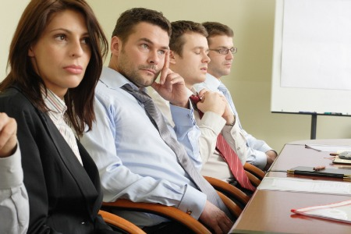
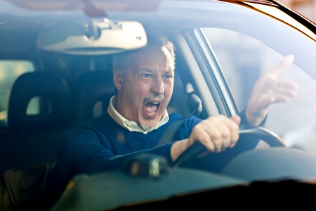
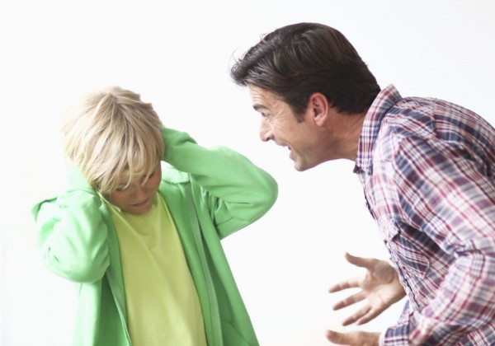
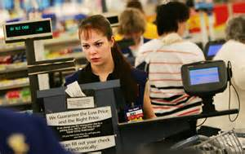
VICTIM MENTALITY - Produces
Situations at Work
Situations while Driving
VICTIM
THINING
Situations at Home
Situations while Shopping
Situations

Slide 25
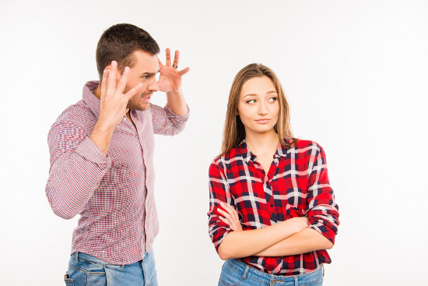
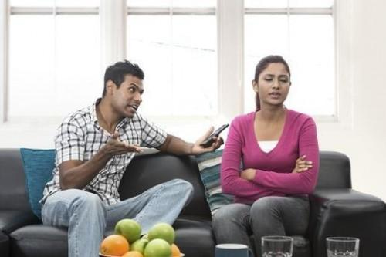
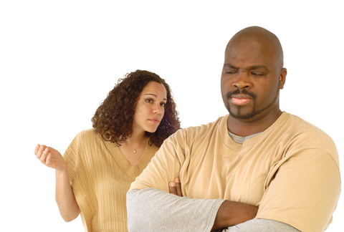
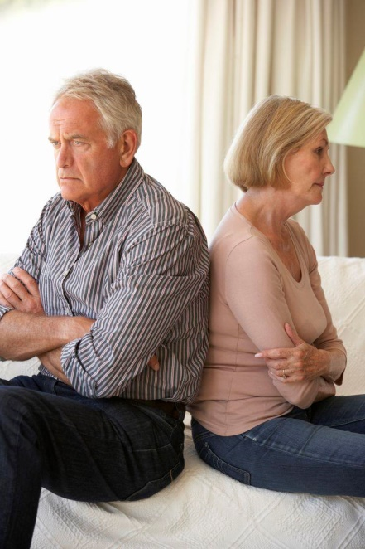
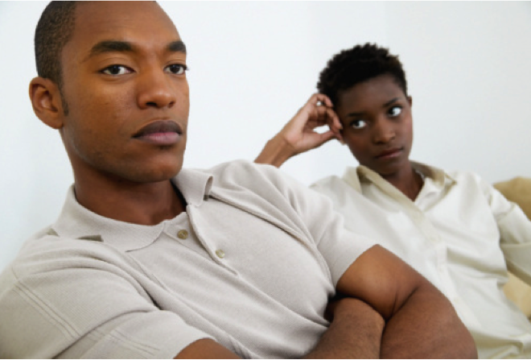
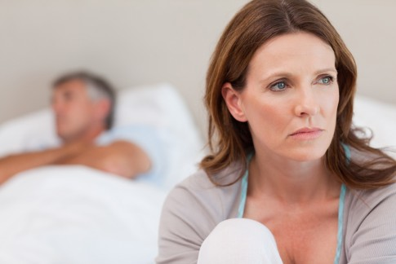
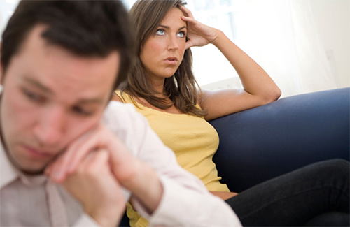
VICTIM THINKING – Produces Problems In
Marriage and Relationships
Relationships

Slide 26
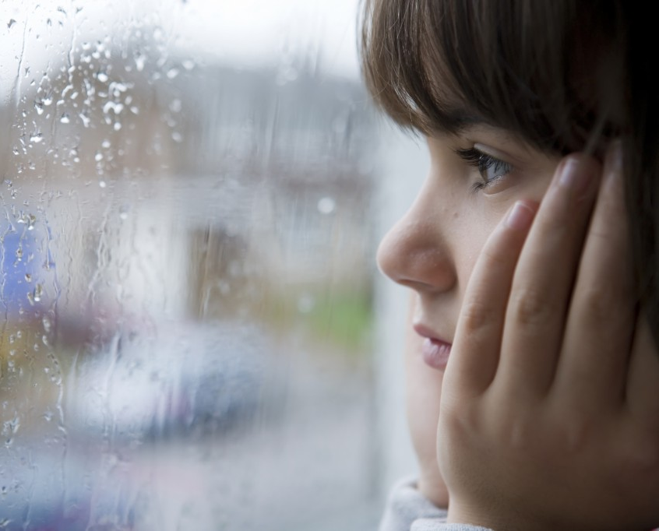
Rainy days and Mondays always…
VICTIM THINKING – Produces the Blues
Controlling Thoughts

Slide 27
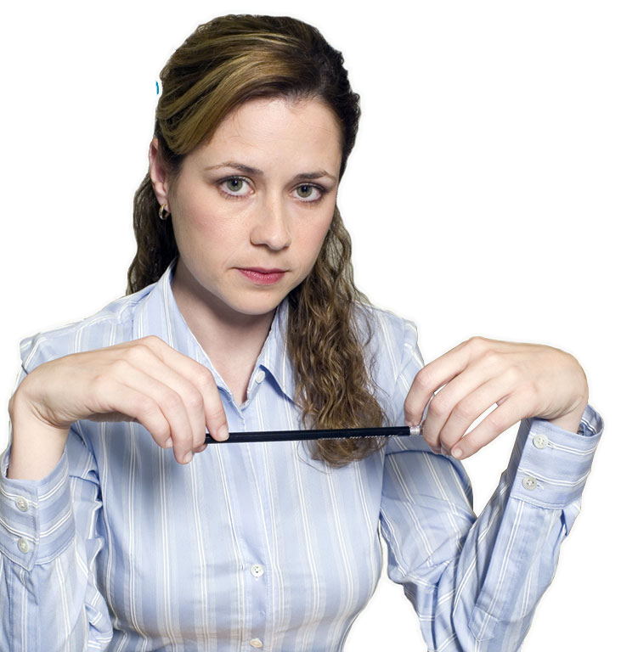
I always feel bad on rainy days
She was a victim to the weather.
Nothing outside of you should control your emotions … that leads to being a victim.

Slide 28
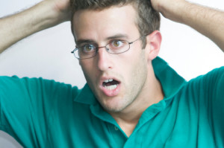
THE VICTIM THINKING
Blame someone else for their problem
Unwilling to take responsibility for actions

Slide 29
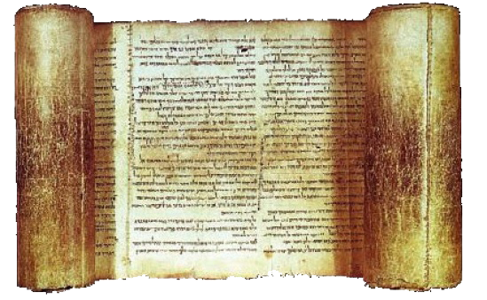
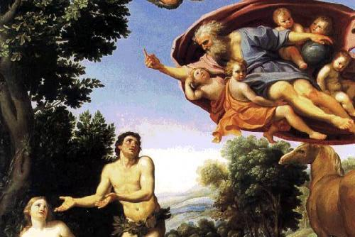
FROM THE BIBLE Adam & Eve
Genesis 3:12-13
The woman whom You gave to be with me, she gave me of the tree, and I ate.”
And the Lord God said to the woman, “What is this you have done?”
The woman said, “The serpent deceived me, and I ate.”

Slide 30
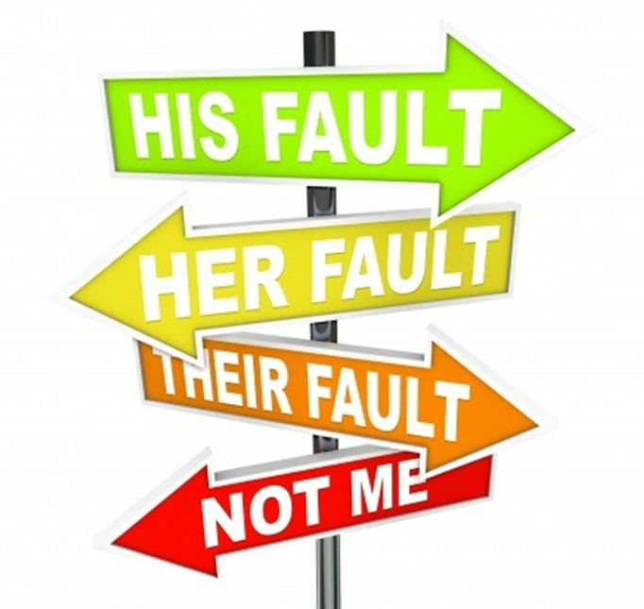
Someone Else Is To Blame

Slide 31
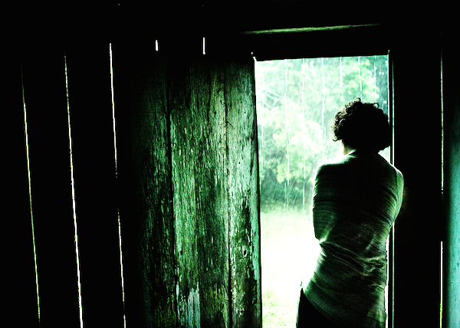
THE VICTIM THINKING
Feel it is right to be emotionally upset
Gain pleasure feeling sorry for themselves

Slide 32
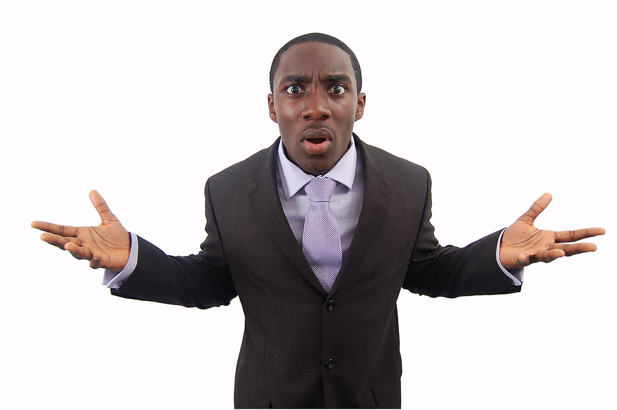
THE VICTIM THINKING
Use the negatives:
“I can’t”
“I had no choice”
“Why me?”
“This always happens to me!”

Slide 33
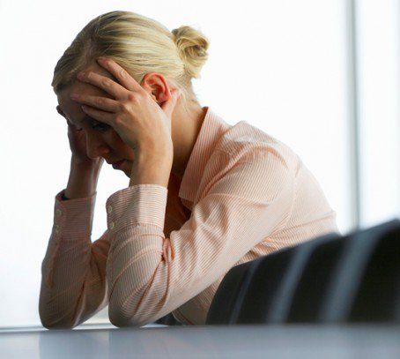
THE VICTIM THINKING- May Generally Be Feeling
Negative
Self-absorbed
Helpless
Powerless
Entitled
Defensive
Stubborn

Slide 34
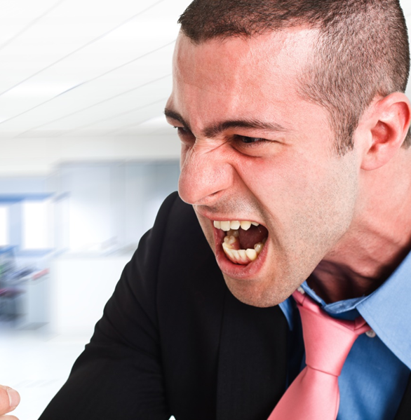

Slide 35
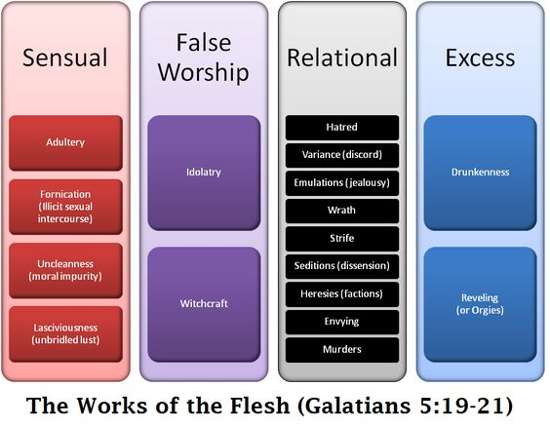

Slide 36
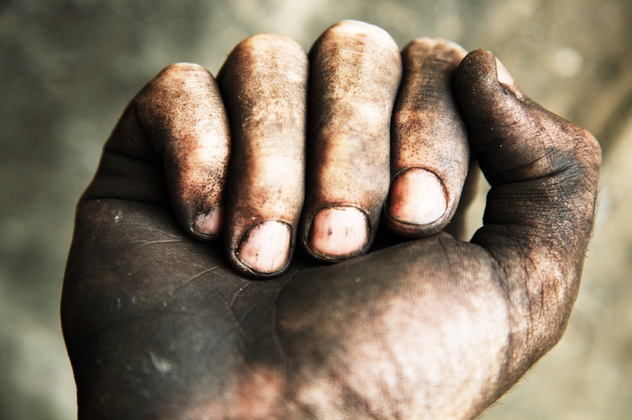
The Works of the Flesh (Galatians 5:19-21)
Sexual Sins
Religious Sins
Attitude Sins
Social Sins

Slide 37
Attitude Sins (Galatians 5:20-21) New Life Version
…hating, fighting, being jealous, being angry, arguing,
dividing into little groups and thinking the other groups are wrong,
false teaching, wanting something someone else has…

Slide 38
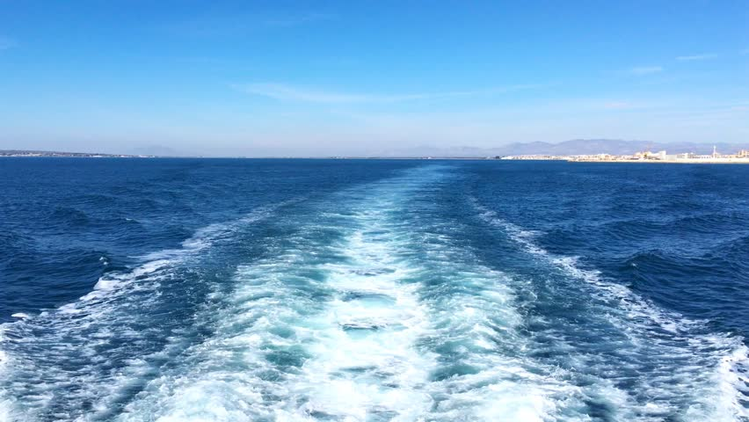
The Wake of Damage

Slide 39
FROM THE BIBLE An Example of Victim Thinking & Its Results

Slide 40
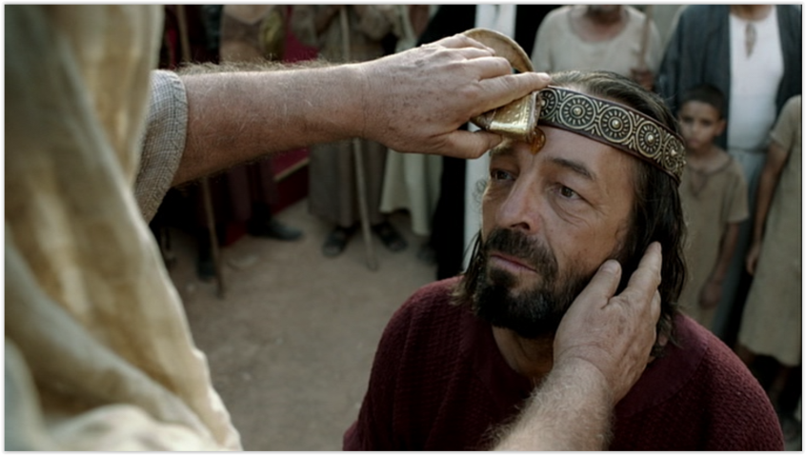
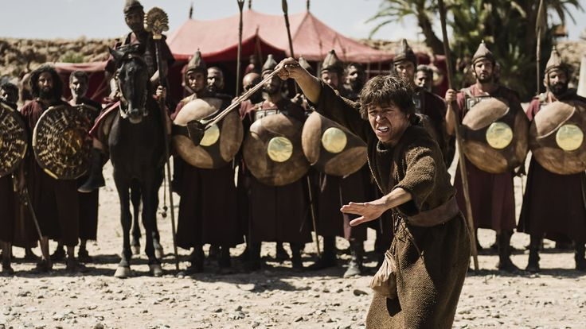
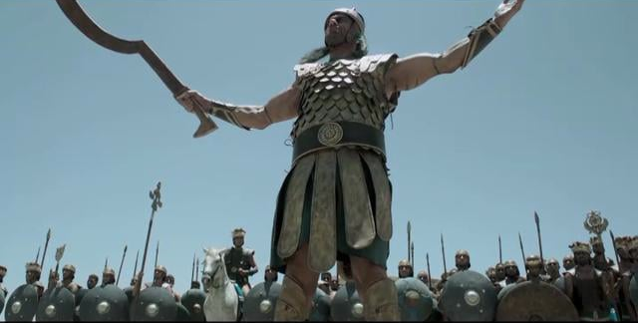
FROM THE BIBLE King Saul
1 Samuel 18:7,9

Slide 41
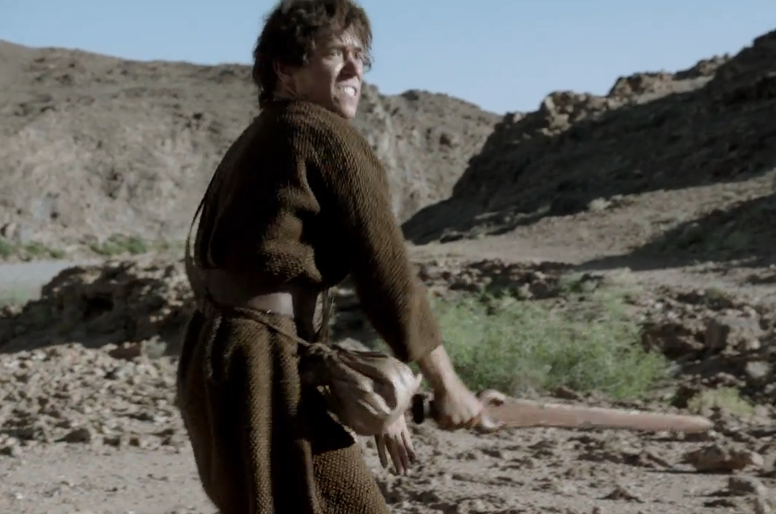
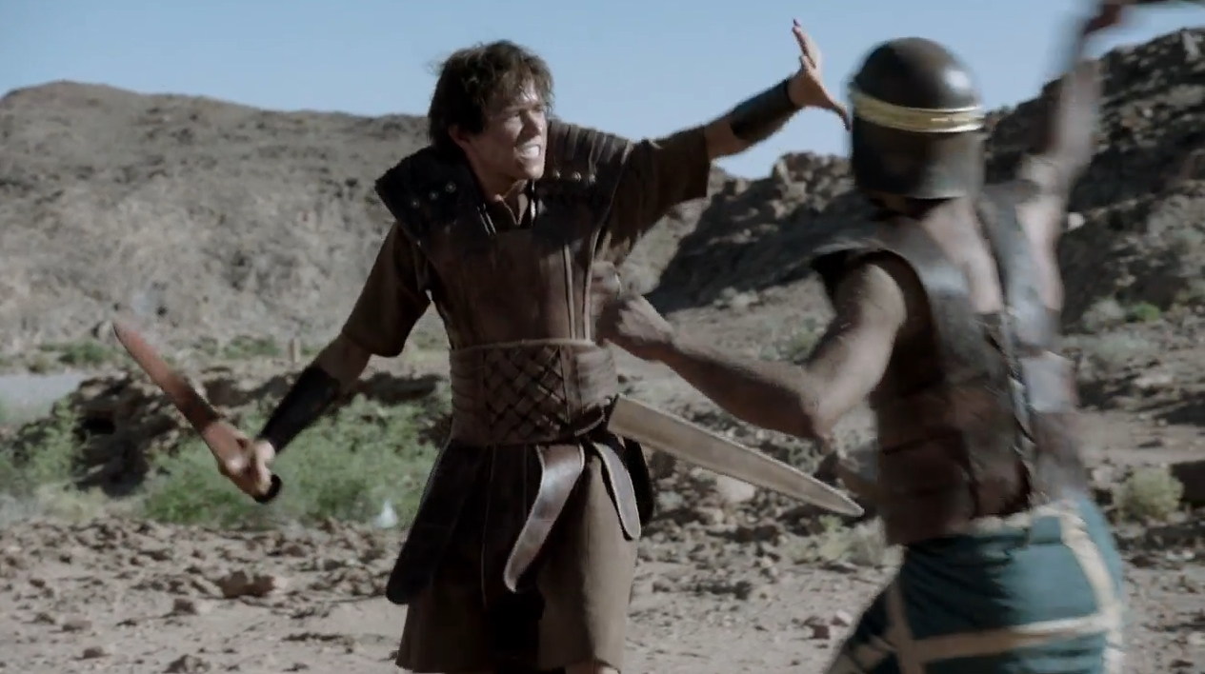
FROM THE BIBLE King Saul

Slide 42
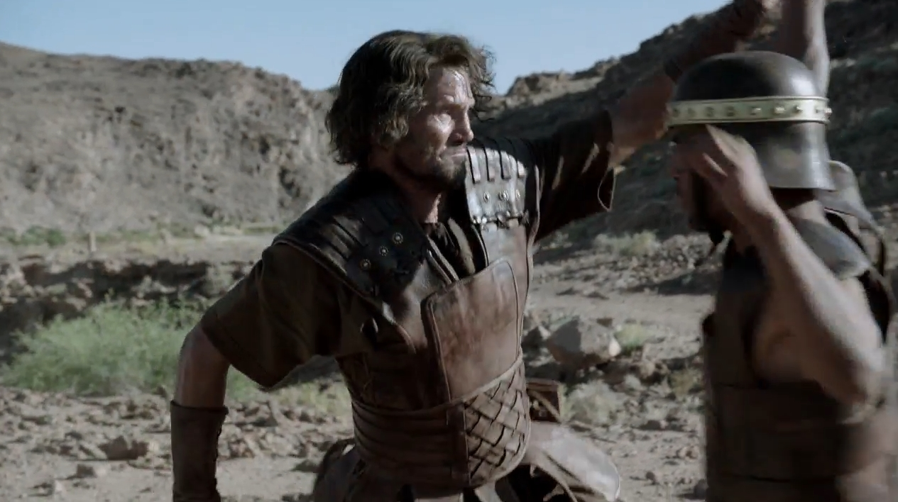
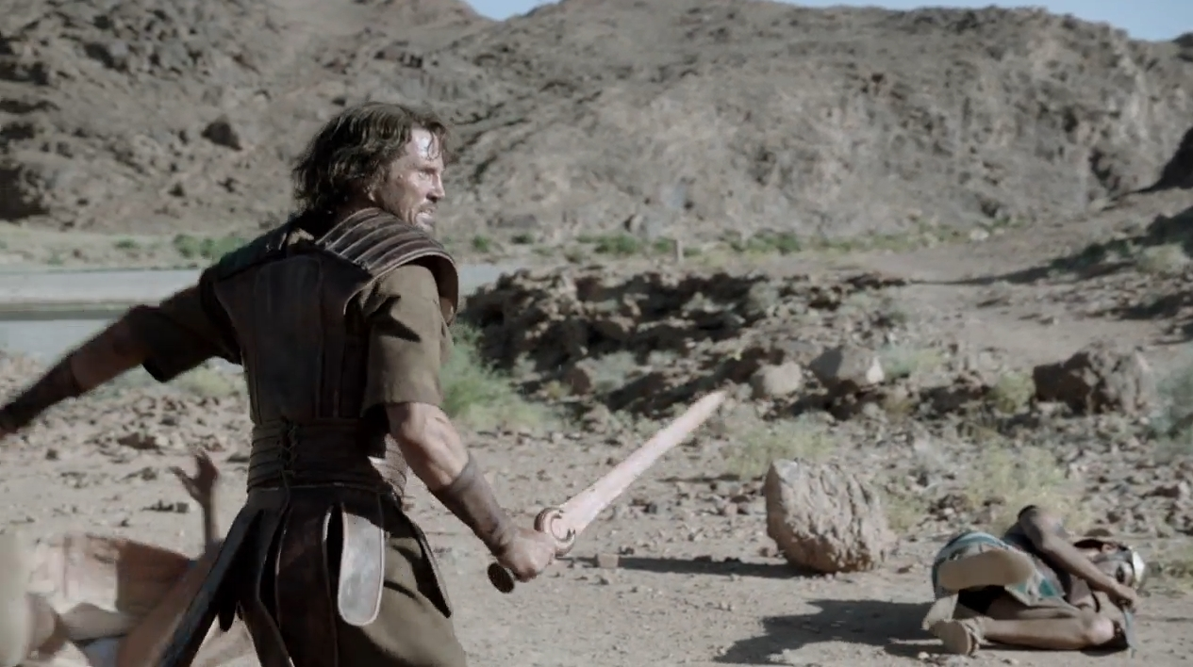
FROM THE BIBLE King Saul

Slide 43
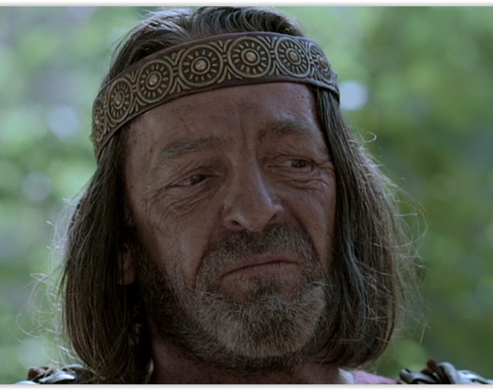
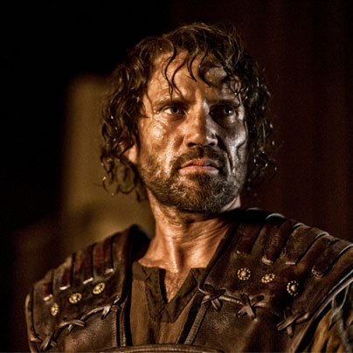
FROM THE BIBLE King Saul
1 Samuel 9-31
Saul has killed his thousands, and David his ten thousands!
So from that time on Saul kept a jealous eye on David.

Slide 44
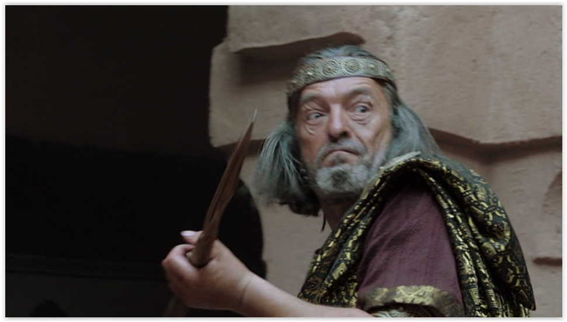
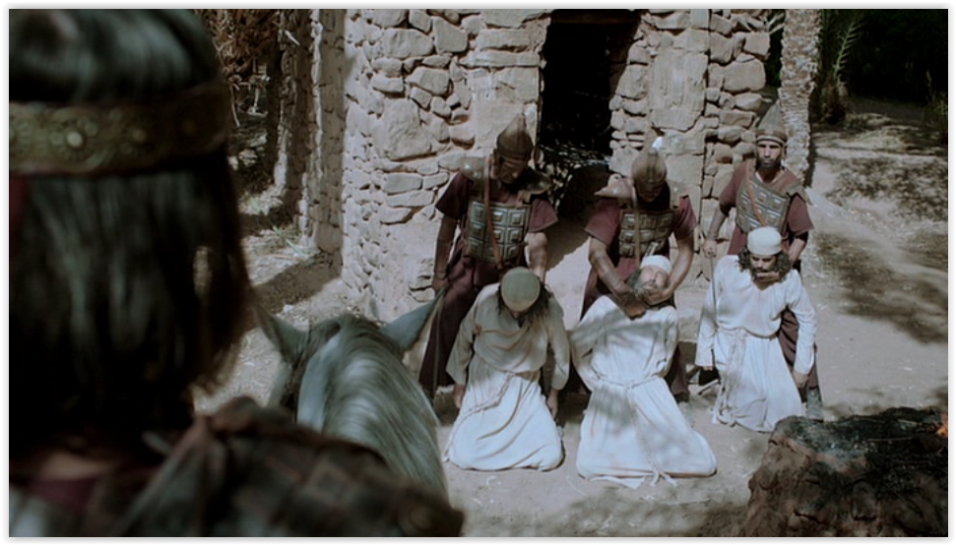
FROM THE BIBLE King Saul

Slide 45
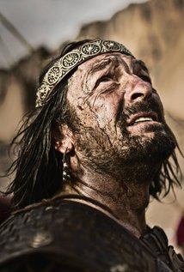
FROM THE BIBLE King Saul
1 Samuel 26:21
I have sinned... I have played the fool and erred exceedingly.

Slide 46
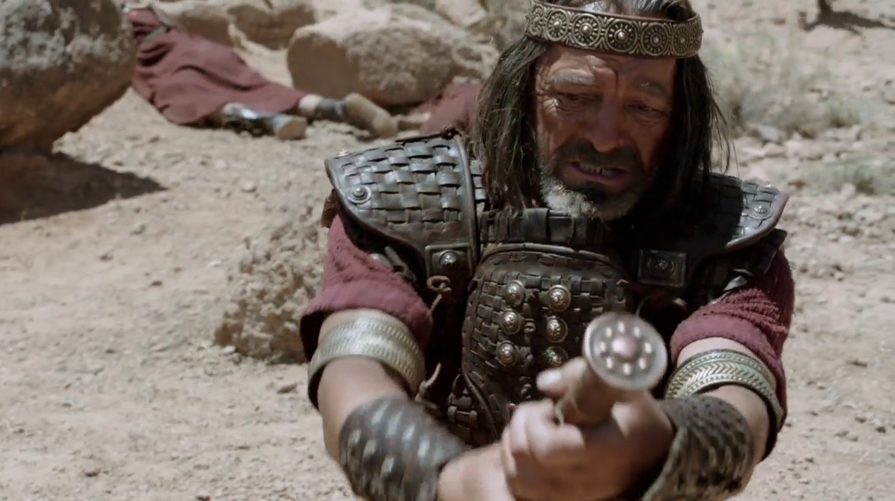
FROM THE BIBLE King Saul

Slide 47
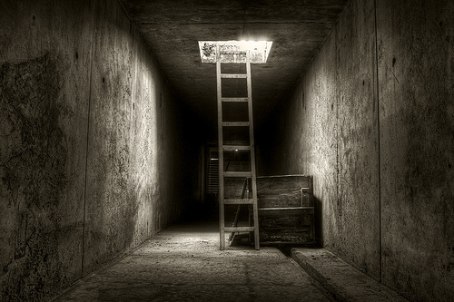
There is a way out of the Victim Thought Pattern
A CHOICE

Slide 48
THE PROCESS
Stimulus
Reaction
Victim Mode

Slide 49
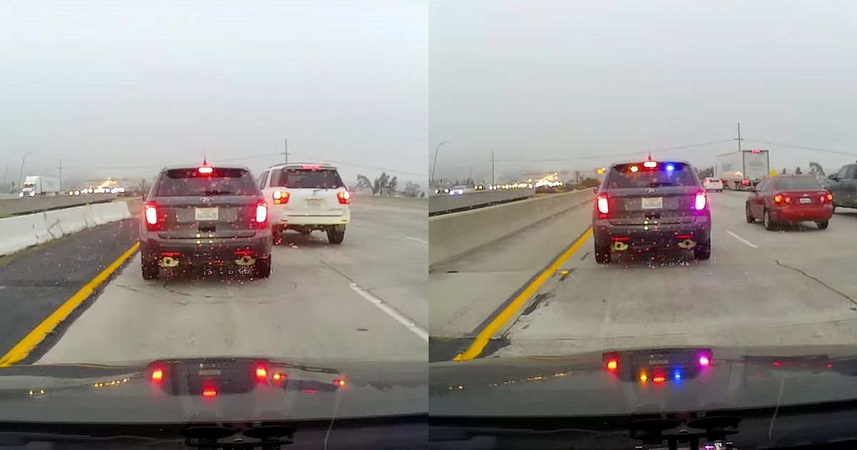

Slide 51
THE PROCESS
Stimulus
Reaction
Victim Mode

Slide 52
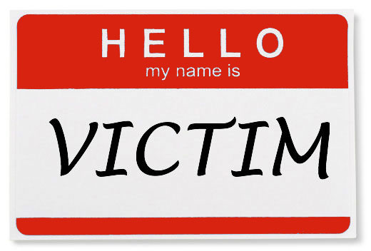
AWARNESS OF VICTIM THINKING
Components of Victim Thinking
1. Thoughts and statements
How often do we
say or think these?

Slide 53
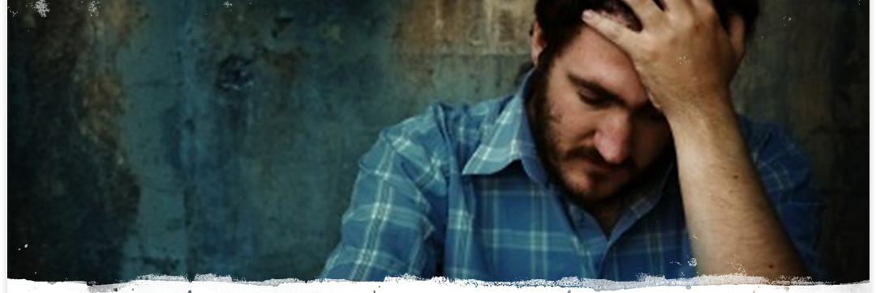
It’s just not fair
It’s all his/her fault
I can’t help it
I can’t win for loosing
I won’t forget what you did
Can you believe she did that to me?

Slide 54
AWARNESS OF VICTIM THINKING
Components of Victim Thinkig
2. Emotions

Slide 55
AWARNESS OF VICTIM THINKING
Components of Victim Thinking
2. Emotions
SEVERE
WEATHER
WARNING
Alert

Slide 56
AWARNESS OF VICTIM THINKING
Components of Victim Thinking
2. Emotions
SEVERE
WEATHER
WARNING
Alert

Slide 57
AWARNESS OF VICTIM MENTALITY
Components of Victim Mentality
2. Emotions
Alert

Slide 59
No trial has overtaken you that is not faced by others. And God is faithful: He will not let you be tried beyond what you are able to bear, but with the trial will also provide a way out so that you may be able to endure it. 1 Corinthians 10:13

Slide 60
FROM THE BIBLE 1 Samuel 30:1-20 The Life of David

Slide 61
FROM THE BIBLE The Life of David

Slide 62
FROM THE BIBLE The Life of David
Now David was greatly distressed…
But David strengthened himself in the Lord his God.
1 Samuel 30:6

Slide 63
FROM THE BIBLE Remembered The Lord’s Presence
And the Lord,
He is the One who goes before you.
He will be with you;
He will not leave you nor forsake you;
do not fear nor be dismayed.”
Deuteronomy 31:8

Slide 64
FROM THE BIBLE Remembered The Lord’s Nature
I will love You, O Lord, my strength. The Lord is my rock
And my fortress and my deliverer; My God, my strength, in whom I will trust; My shield and the horn of my salvation, my stronghold. I will call upon the Lord,
who is worthy to be praised; So shall I be saved from my enemies.
Psalm 18:1-3

Slide 65
FROM THE BIBLE Remembered The Lord’s Goodness
Abraham
Isaac – Jacob
Joseph
Moses
Joshua
Deborah
Gideon – Samson
Ruth and Boaz

Slide 66
FROM THE BIBLE Remembered The Lord’s Nature
When Problems Come
Glance At Them
But
Gaze Upon God

Slide 67
Simple Tool
Lord, how they have increased who trouble me! Many are they who rise up against me. Many are they who say of me, “There is no help for him in God.”
But You, O Lord, are a shield for me, My glory and the One who lifts up my head.
Psalm 3:1-3
BUT

Slide 68
Simple Tool
But You, O Lord…

Slide 69
Lord, how they have increased
who trouble me! Many are they who
rise up against me. Many are they who say of me, “There is no help for him in God.”
But You, O Lord, are a shield for me, My glory and the One
who lifts up my head.
Psalm 3:1-3

Slide 71
Thoughts in Victim Thinking
Someone or something
is responsible for my situation!
I have a right to be upset!
This is really bad for me!

Slide 72
It’s so hard for me
I my parents were terrible
I’m overwhelmed
Nobody works as hard as I do around here
I can’t trust anybody
I been traumatized for life
Things always go wrong for me
Watching the news makes me angry, scared, upset, helpless…

Slide 73
Realizing God Has Empowered us to live without feeling like a victim
THE GOAL
Eliminating any “Victim Mentality” in Ourselves

Slide 74
As believers we have the Holy Spirit
He will provide help as we ask.

