Slide 1
As believers we have the Holy Spirit
He will provide help as we ask.

Slide 2
Romans 8:5 Those who live according to the flesh have their minds set on what the flesh desires; but those who live in accordance with the Spirit have their minds set on what the Spirit desires.

Slide 3
Romans 8:6-7 The mind governed by the flesh is death, but the mind governed by the Spirit is life and peace. The mind governed by the flesh is hostile to God; it does not submit to God’s law, nor can it do so.

Slide 4
Romans 8:8 Those who are in the realm of the flesh cannot please God

Slide 5
Romans 8:9-10 You, however, are not in the realm of the flesh but are in the realm of the Spirit, if indeed the Spirit of God lives in you. And if anyone does not have the Spirit of Christ, they do not belong to Christ. But if Christ is in you, then even though your body is subject to death because of sin, the Spirit gives life because of righteousness.

Slide 6
Romans 8:11-12 And if the Spirit of him who raised Jesus from the dead is living in you, he who raised Christ from the dead will also give life to your mortal bodies because of his Spirit who lives in you. Therefore, brothers and sisters, we have an obligation—but it is not to the flesh, to live according to it.

Slide 7
Romans 8:13 For if you live according to the flesh, you will die; but if by the Spirit you put to death the misdeeds of the body, you will live.

Slide 8
Romans 8:14 For those who are led by the Spirit of God are the children of God.

Slide 9
Hearing God
in our daily lives

Slide 10
Can We Hear From God?
Reality, Motive, Blocks to Reception

Slide 11
Discerning the Sound
Knowing different voices

Slide 12
Understanding Listening
Guidelines - The Word of God

Slide 13
Assignments in Active Listening
Ministry Opportunities

Slide 14
Does God Really
Speak To People?
?

Slide 15
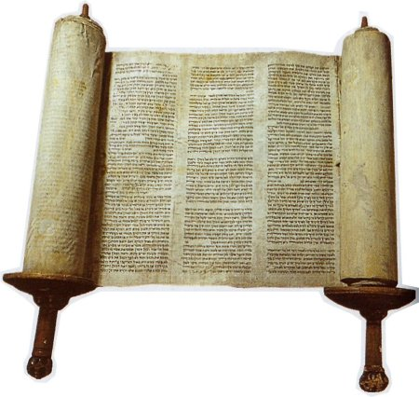
To whom has God spoken?
Genesis 1
The Elements
They hear and respond
From the
Old Testament

Slide 16
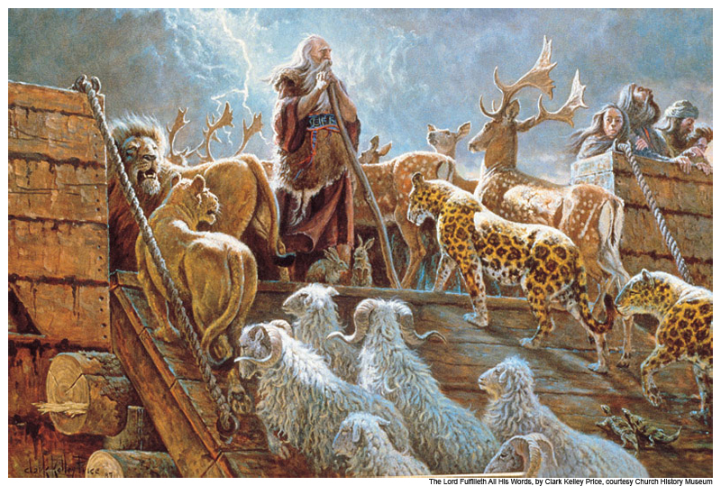
To whom has God spoken?
Genesis 6:7-9
The Animals
They hear and respond
From the
Old Testament

Slide 17
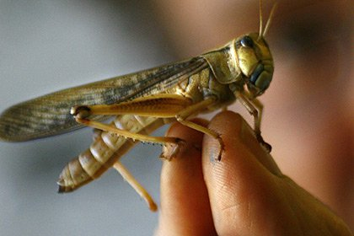
To whom has God spoken?
2 Chronicles 7:13
The Locusts
They hear and respond
From the
Old Testament

Slide 18
Who has heard God speak?
Adam & Eve – Before & After
Cain – Before & After
Noah
Abraham – Isaac – Jacob
King Abimelech
Joseph
Moses – Aaron
Joshua
Deborah – Gideon – Samson’s Parents
From the
Old Testament

Slide 19
Who has heard God speak?
Samuel
David
Solomon
Gad – Nathan – Elijah – Elisha
Isaiah – Jeremiah – Ezekiel
Daniel – Hosea – Joel – Amos – Obadiah – Jonah – Micah – Nahum – Habakkuk – Zephaniah - Haggai – Zechariah - Malachi
From the
Old Testament

Slide 20
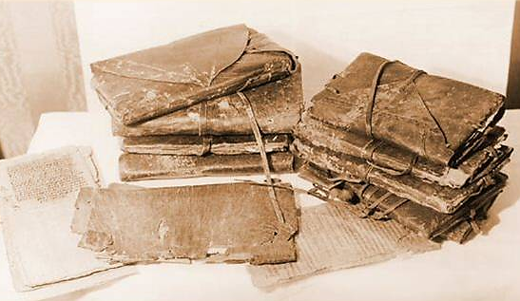
Who has heard God speak?
Zacharias - Joseph – Mary
Peter
Philip
Saul – later named Paul
Ananias
Cornelius
People in the church at Antioch
From the
New Testament

Slide 21
Who has heard God speak?
Paul, Silas, Timothy forbidden to go to Asia
Paul shipwreck
The Apostle John – Book of Revelation
Jesus
From the
New Testament

Slide 22
Who can hear God speak?
And when He has come, He will convict the world of sin, and of righteousness,
and of judgment
John 16:8
No one can come to Me unless the Father who sent Me draws him
John 6:44
Anyone

Slide 23
Who can hear God speak?
My Story

Slide 24
Who can hear God speak Regularly?
And other sheep I have which are not of this fold;
them also I must bring,
and they will hear My voice;
John 10:16
Believers

Slide 25
Why Should We Want To Hear God Speak To Us?
?

Slide 26
Why should we want to hear God speak?
Adam and Eve
Genesis 2 - 3
God created man for Relationship with Himself

Slide 27
Why should we want to hear God speak?
And this is eternal life, that they may know You, the only true God, and Jesus Christ whom You have sent.
John 17:3
God created man for Relationship with Himself

Slide 28
Why Should We Want To Hear God Speak To Us?
1 Relationship

Slide 29
Why should we want to hear God speak?
Then He appointed twelve, that they might be with Him and that He might send them out to preach, and to have power to heal sicknesses and to cast out demons.
Mark 3:14-15
Jesus appointed people for Relationship with Himself

Slide 30
Why should we want to hear God speak?
However, when He, the Spirit of truth, has come, He will guide you into all truth;
John 16:13
2. Guiding into Truth

Slide 31
Why should we want to hear God speak?
My Story
2. Guiding into Truth

Slide 32
Why Should We Want To Hear God Speak To Us?
Relationship
Guidance in Truth

Slide 33
Why should we want to hear God speak?
However, when He, the Spirit of truth, has come, He will guide you into all truth; for He will not speak on His own authority, but whatever He hears He will speak; and He will tell you things to come. John 16:13
2. Future Expectations

Slide 34
Why should we want to hear God speak?
My Story
Future Expectations

Slide 35
Why Should We Want To Hear God Speak To Us?
Relationship
Guidance in Truth
Personal Future

Slide 36
Why should we want to hear God speak?
Grace and peace be multiplied to you in the knowledge of God and of Jesus our Lord,
as His divine power has given to us all things that pertain to life and godliness, through the knowledge of Him who called us by glory and virtue,
2 Peter 1:2-3

Slide 37
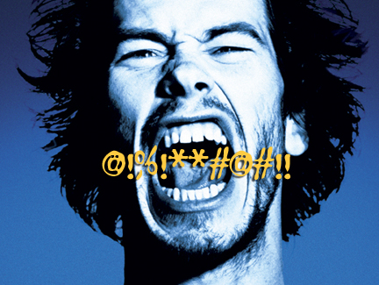
Why should we want to hear God speak?
My Story

Slide 38
Why Should We Want To Hear God Speak To Us?
Relationship
Guidance in Truth
Personal Future
Knowledge of God

Slide 39
Why Do People
Not Hear God?
?

Slide 40
Why Not Hear?
My sheep
hear My voice,
and I know them,
and they follow Me.
John 16:27
1.
Not Think God is Speaking

Slide 41
Why Not Hear?
To him the doorkeeper opens, and the sheep hear his voice; and he calls his own sheep by name and leads them out.
And when he brings out his own sheep, he goes before them; and the sheep follow him, for they know his voice.
John 10:3-4
1.
Not Think God is Speaking
to me

Slide 42
Why Not Hear?
But the natural man does not receive the things of the Spirit of God, for they are foolishness to him; nor can he know them, because they are spiritually discerned
1 Corinthians 2:14
1.
Not Think God is Speaking
to me

Slide 43
Why Not Hear?
But he who is spiritual judges all things, yet he himself is rightly judged by no one. For “who has known the mind of the Lord that he may instruct Him?” But we have the mind of Christ
1 Corinthians 2:15-16
1.
Not Think God is Speaking
to me

Slide 44
Why Not Hear?
Do not think God is speaking to them
For the hearts of this people
have grown dull. Their ears are hard of hearing, And their eyes they have closed
Matthew 13:15

Slide 45
Why do we not hear the Voice of God?
And you will seek Me and find Me, when you search for Me with all your heart.
I will be found by you, says the Lord,
Jeremiah 29:13-14
2. Not seeking God with all your heart

Slide 46
Why Not Hear?
Do not think God is speaking to them
Not seeking the Lord with all their heart – Half hearted
a double-minded man, unstable in all his ways
James 1:8

Slide 47
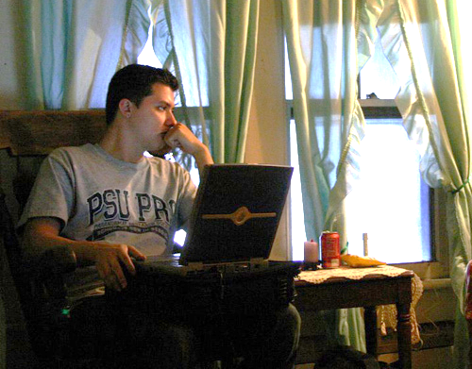
Why do we not hear the Voice of God?
Be still,
and know that I am God
Psalm 46:10
3. Not being Quiet

Slide 48
Why do we not hear the Voice of God?
Draw near to God and He will draw near to you.
James 4:8
3. Not being Quiet to Focus

Slide 49
Why Not Hear?
Do not think God is speaking to them
Not seeking the Lord with all their heart – Half hearted
3. Not becoming quiet and getting focused on God
?

Slide 50
Hearing God
in our daily lives

Slide 51
Part 2 - The Way God Speaks To US
Knowing different voices

Slide 52
God two ways God
speaks to His people?

Slide 53
Two
Supernatural parents of our spiritual birth?

Slide 54
…having been born again, not of corruptible seed but incorruptible, through
the Word of God
which lives and abides forever
1 Peter 1:23
1.
The Word
of God

Slide 55
2.
The Spirit
of God
So is everyone
who is born of
the Spirit
John 3:8

Slide 56
Two ways
God
Speaks to
His people?

Slide 57
The First Way God Speaks To His People
His
Written Word

Slide 58
The Second Way God Speaks To His People
The Ministry
of
the Holy Spirit

Slide 59
MAN HAS: A Body A Soul
MAN IS: A Spirit Being

Slide 60
Human Beings are
BODY
World-conscious using the senses of seeing, hearing, tasting, smelling and touching.
SOUL
Self-conscious using intelligence, reason, emotion and will.
SPIRIT
God-conscious and is able to know, worship, trust and glorify Him.

Slide 61
Speaking in our thoughts
The Voice of Reason
The Voice of the Holy Spirit
The Voice of the evil one

Slide 62
Voice of Reason
Self talk – from observation
You will deliberate
and think things through,
and afterwards,
make your decision.

Slide 63
Voice of Reason
Not bad but can be prejudiced by …
Mark 2:1-8 Scribes Reason
Acts 28:1-6 People of Malta

Slide 64
Voice of Reason
Numbers 13:26-33
NOTE:
If the answer of your mind
contradicts the Written Word,
or contradicts what God has said
then you must abandon
the voice of your reasoning

Slide 65
Speaking in our thoughts
The Voice of the evil one

Slide 66
The Voice of Satan
Deceive you, (Revelation 20:7-8)
Bring Oppression, (Acts 10:38)
Discourage (Numbers 32:6-10)
Inspire rage, anger & malice, (Ephesians 4:31)

Slide 67
The Voice of Satan
Encourage you to:
Bitterness, (Colossians 3:19)
Confusion, (Acts 19:32)
Rationalize sin, (Isaiah 5:20)
Lying, (I John 2:4)
Doubt God's Word, (Hebrews 3:12)
Division in your family, church, business,
(Mark 3:25)
Disobey the Word of God, (Joshua 5:6)

Slide 68
The Voice of Satan
Encourage you to:
Be fearful (Mark 4:40)
Lose hope, (Job 7:1-15)
Be dismayed, (Joshua 1:9)
Seek revenge, (Ezekiel 25:15)
Curse God, (Job 2:9)
Stir up unforgiveness,
(Matthew 6:15)
To be ashamed of the gospel, (Mark 8:38)
To think you cannot to hear God’s voice, (John 10:10)

Slide 69
Speaking in our thoughts
The Voice of the Holy Spirit

Slide 70
Growing Strong
God helps some people more than others
He is not respecter of persons

Slide 71
Growing Strong
Why?
Some have learned to depend on and yield to Him more than others

Slide 72
Growing Strong
That is developed
More your spirit developed – the more sensitive to Holy Spirit

Slide 74
Growing Strong
Hebrews 5:14
Senses exercised
to discern both
good and evil

Slide 75
Growing Strong
1.
Get into the Word
Luke 24:25-26
Luke 24:42-48

Slide 76
Get into Word
Filled with Spirit
No Fellowship with Demons

Slide 77
5. Follow Example
6. Walk in the Spirit
7. Peruse Love

Slide 78
Recognizing Conviction
The Holy Spirit
Gives a sense of holiness
Gives a sense of
God-consciousness through the Word
Satan
Gives a sense of worthlessness
Gives a sense of
self-consciousness through feelings

Slide 79
Recognizing Conviction
The Holy Spirit
Satan
Generally deals with one thing at a time
Throws the “whole book”
Usually quiet
Usually with major clamoring
Specific with clarity
General with confusion

Slide 80
Recognizing Conviction
The Holy Spirit
Satan
Corrects
Accuses
Convicts
Condemns
Deals with unconfessed sin
Deals with
confessed sin

Slide 81
Recognizing Conviction
The Holy Spirit
Satan
Encourages to obedience
Discourages to despair
Gives peace
with a sense of confirmation
Gives pressure with a sense of frustration
Leads to a life of balance
Leads to a life of bondage

Slide 82
Recognizing Conviction
The Holy Spirit
Satan
Deals in sincerity
and love
Deals in subtlety and anger

Slide 83
God’s Promptings Always agree with the Written Word of God May contradict your feelings Can be easily rejected Have His character of Love Produce good fruit Are for Friendship – Relationship

Slide 85
Assignments in Active Listening
Ministry Opportunities

Slide 86
Prayer Points
Thank God He is speaking to your partner
Ask God to tune their heart to seek Him fully (whole hearted desire for Him)
Quite your heart and focus on Him

Slide 87
Activity Points
Ask God to bring a thought to your mind about a blessing of His salvation that he has brought into the life of your prayer partner.
Pray that blessing over them.

Slide 90
1 Samuel 3:9
Remember how Eli encouraged Samuel
if He calls you, that you must say,
‘Speak, Lord, for Your servant hears.’

